Slide 1




Towards Efficient Ridesharing via Order-Vehicle Pre-Matching Using Attention Mechanism
Zhidan Liu¹, Jinye Lin², Zhiyu Xia², Chao Chen³, Kaishun Wu¹

Slide 2

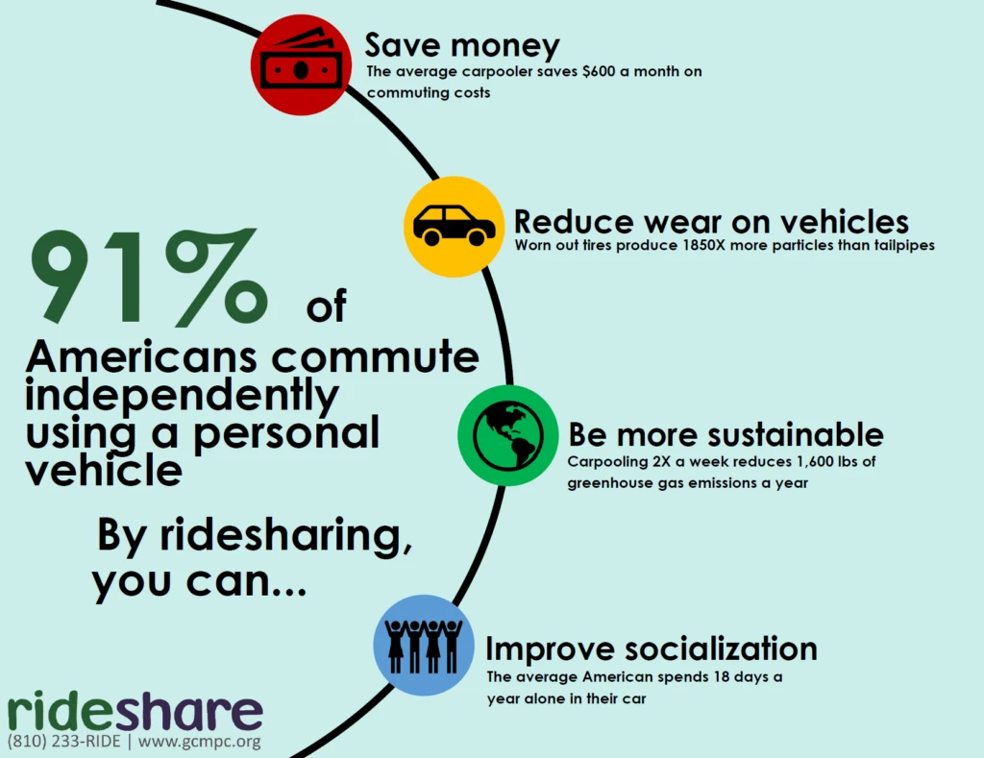
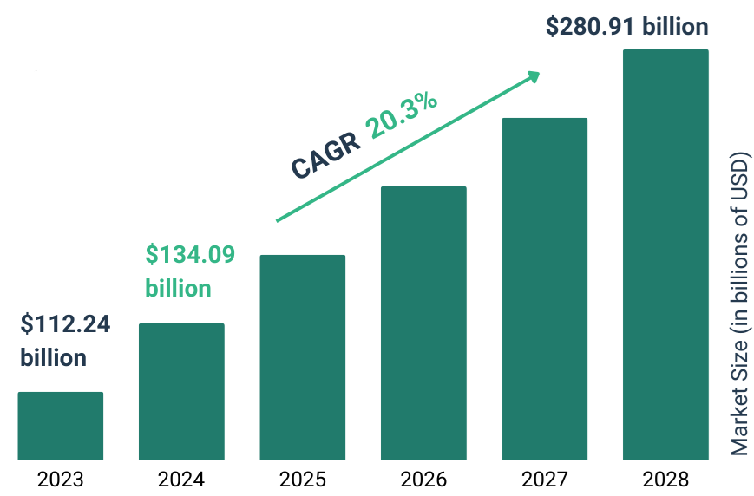
Ridesharing
Ridesharing allows multiple passengers with the similar itineraries and time schedules to share a vehicle
Various benefits, with respect to drivers, passengers, and environments
Growing market and huge potentials
Source:
[1] Rideshare, https://gcmpc.org/rideshare/.
[2] Ride Sharing Market Report 2024, https://www.thebusinessresearchcompany.com/report/ride-sharing-global-market-report.

Slide 3
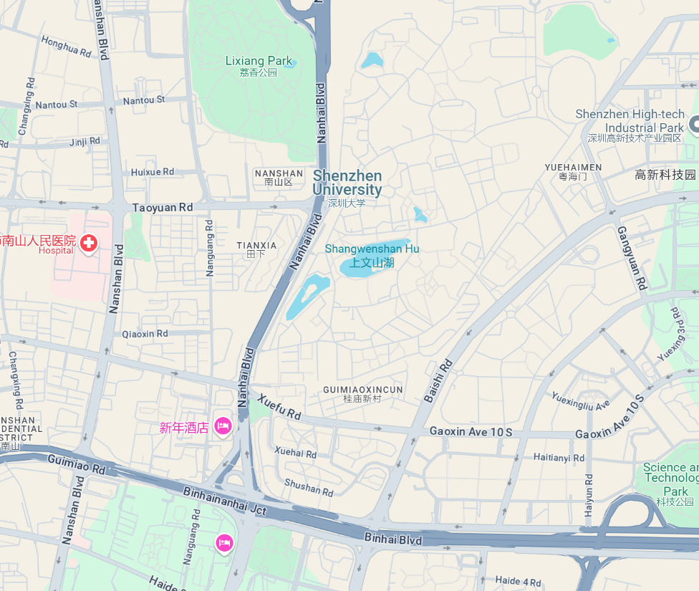
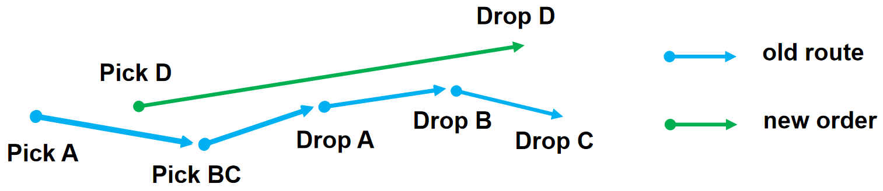
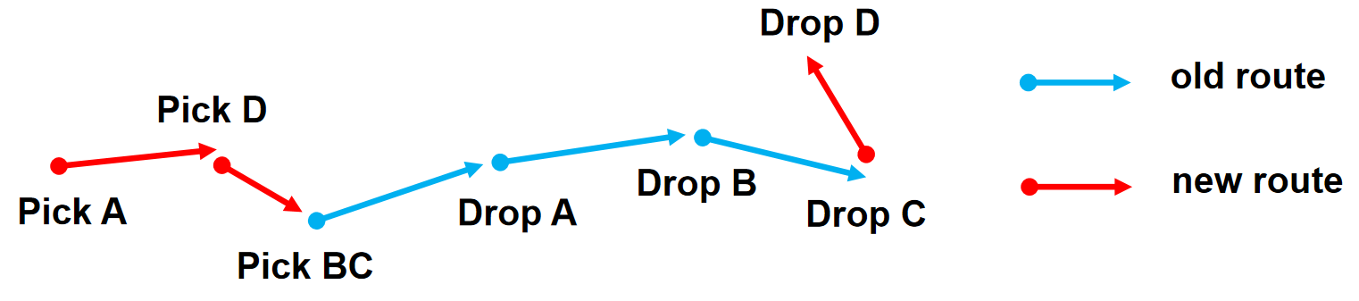
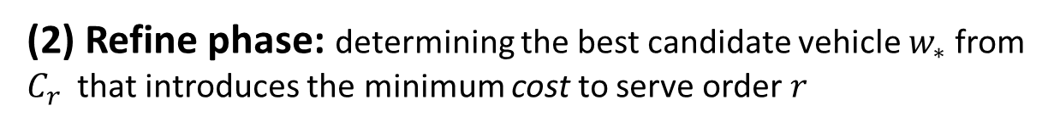
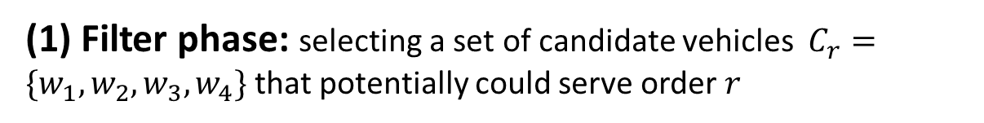
Ridesharing
The “filter-and-refine” framework for order-vehicle matching
(1) Filter phase: selecting a set of candidate vehicles $C_{r}=\{w_{1},w_{2},w_{3},w_{4}\}$ that potentially could serve order $r$
(2) Refine phase: determining the best candidate vehicle $w_{∗}$from $C_{r}$ that introduces the minimum cost to serve order $r$
order
Search range
Insert new order
Notes:
In the refine phase, each candidate vehicle is then subjected to route planning in order to determine the most suitable vehicle for fulfilling order r.

Slide 4
Ridesharing
The relatively large candidate sets, incurring unnecessary computations
One question we ask:
Can we reduce the candidate sets while preserving the service quality of ridesharing?
Large candidate sets result in huge computational costs and long response time
[1] Mobility-aware dynamic taxi ridesharing, IEEE ICDE 2020.
[2] A unified approach to route planning for shared mobility, VLDB 2018.
[3] Unified route planning for shared mobility: an insertion-based framework. ACM Transactions on Database Systems, 2022.
Notes:
Within the filter-and-refine framework, the size of candidate sets will determines the computational efficiency of ridesharing systems.
Table I reveals that existing representative algorithms produce a substantial number of candidate vehicles for each order, and the size of the candidate set increases significantly with an increase in the number of vehicles.

Slide 5
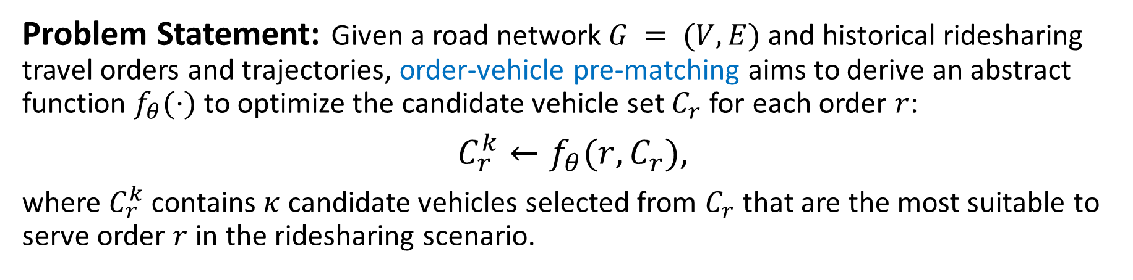
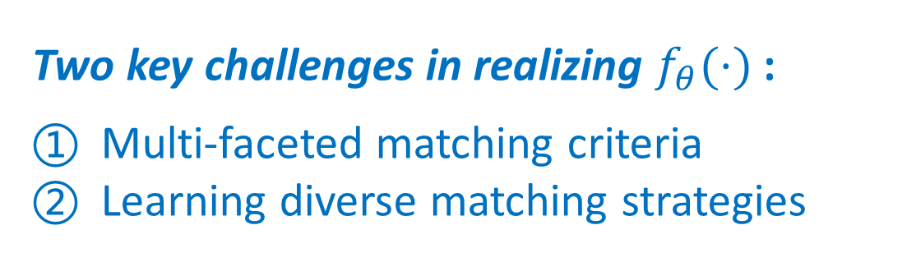
Problem of Order-Vehicle Pre-Matching
Problem Statement: Given a road network $G = (V, E)$and historical ridesharing travel orders and trajectories, order-vehicle pre-matching aims to derive an abstract function $f_{θ}(·)$to optimize the candidate vehicle set $C_{r}$ for each order $r$:
$C_{r}^{k}←f_{θ}(r,C_{r})$,
where $C_{r}^{k}$ contains $κ$ candidate vehicles selected from $C_{r}$ that are the most suitable to serve order $r$ in the ridesharing scenario.
Two key challenges in realizing $f_{θ}(·)$:
Multi-faceted matching criteria
Learning diverse matching strategies
Notes:
Matching between order and vehicles considers a wide range of factors, including rider’s pick-up and drop-off locations, time constraints, and candidate vehicle’s already planned schedule and travel route.
Existing ridesharing systems employ diverse strategies to match orders and vehicles, either heuristic or optimization, the function needs to learn and simulate their decision process underlying these strategies.

Slide 6
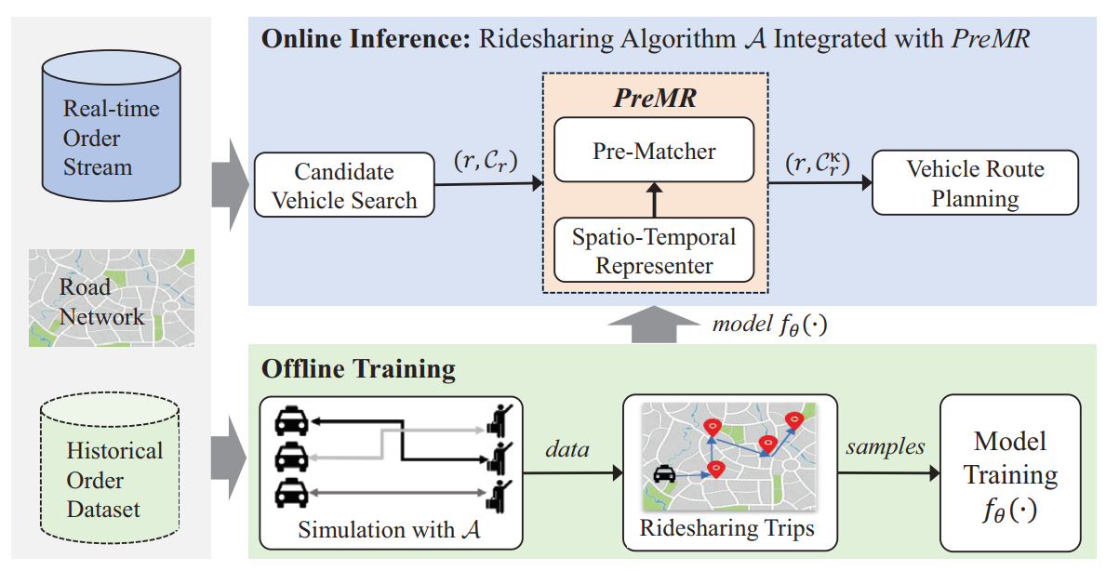
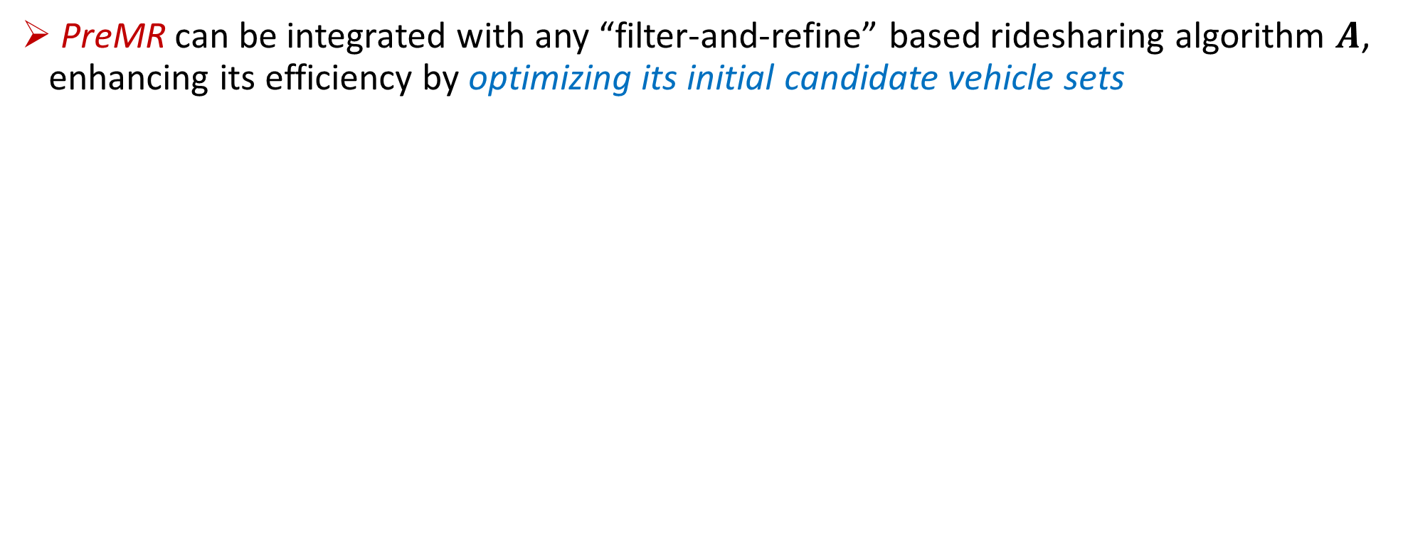
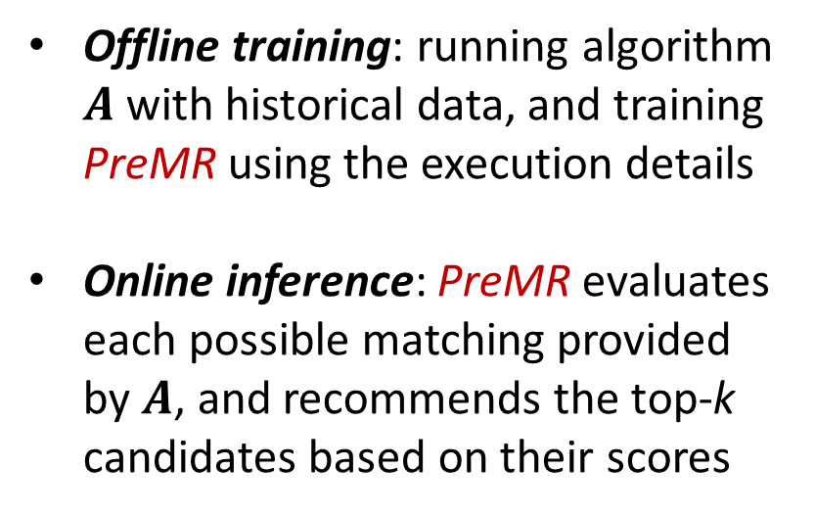
Our Solution: PreMR
PreMR can be integrated with any “filter-and-refine” based ridesharing algorithm $A$, enhancing its efficiency by optimizing its initial candidate vehicle sets
Offline training: running algorithm $A$ with historical data, and training PreMR using the execution details
Online inference: PreMR evaluates each possible matching provided by $A$, and recommends the top-k candidates based on their scores

Slide 7
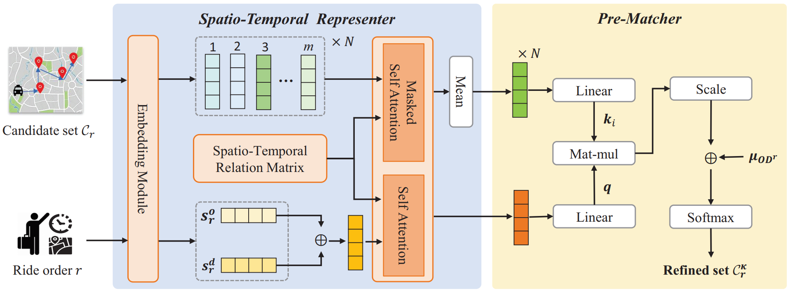
Design of PreMR
Architecture of PreMR
Spatio-temporal representer encodes information of order and candidate vehicles
Pre-matcher recommends a ranked set of k candidates for order r

Slide 8
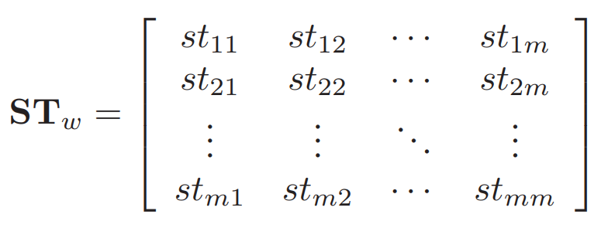
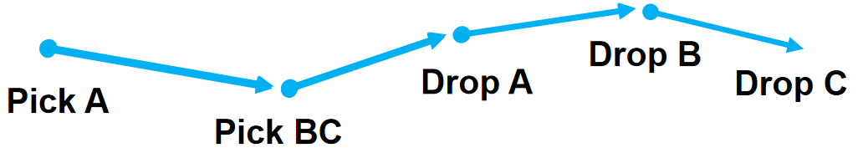

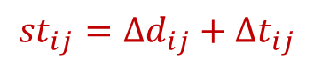
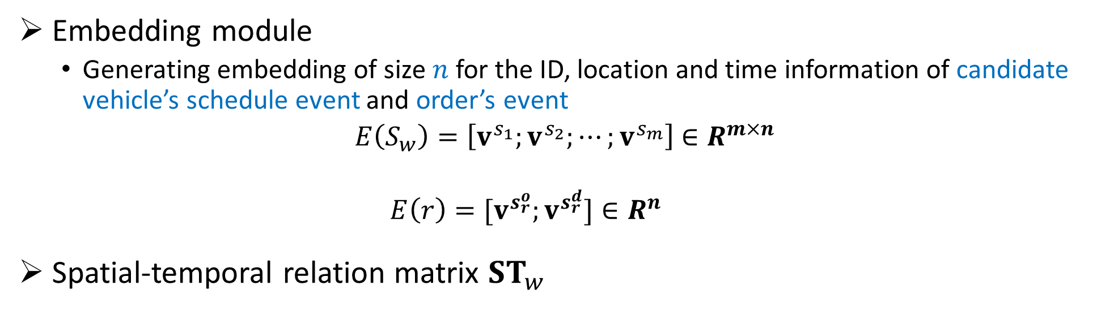
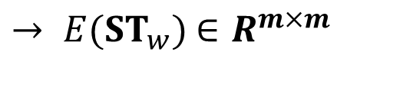

Design of Spatio-Temporal Representer
Embedding module
Generating embedding of size $n$ for the ID, location and time information of candidate vehicle’s schedule event and order’s event
$E\left(S_{w}\right)=\left[v^{s_{1}};v^{s_{2}};⋯;v^{s_{m}}\right]$ $∈R^{m×n}$
$$E\left(r\right)=[v^{s_{r}^{o}};v^{s_{r}^{d}}]∈R^{n}$$
Spatial-temporal relation matrix ${ST}_{w}$
$→ E({ST}_{w})$ $∈R^{m×m}$
event $s_{i}$
event $s_{j}$
$${st}_{ij}={∆d}_{ij}+{∆t}_{ij}$$

Slide 9
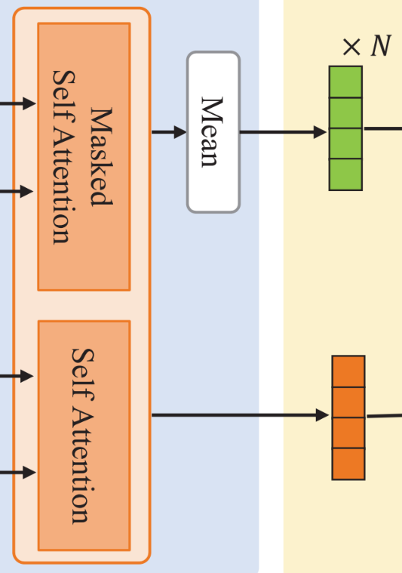
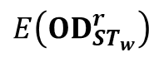
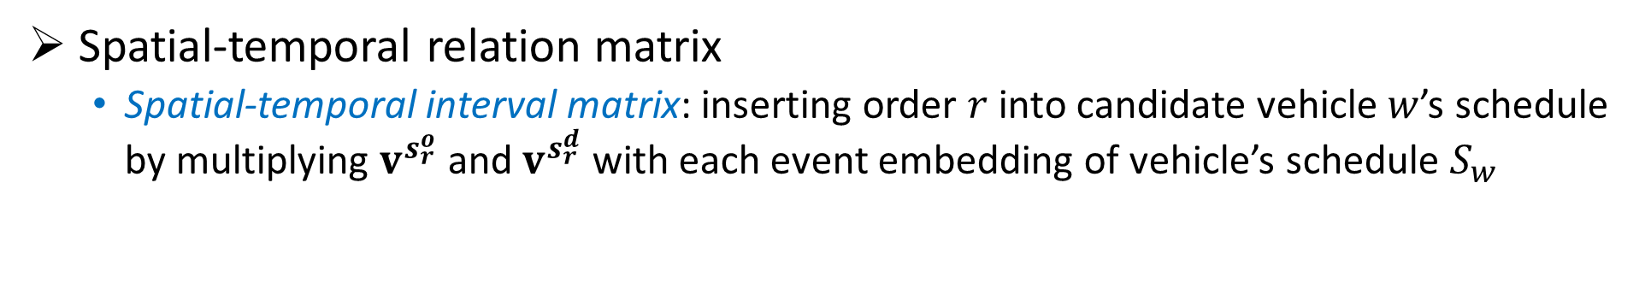
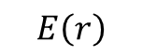
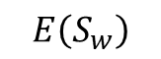
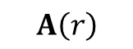
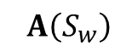
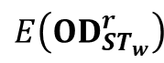
Design of Spatio-Temporal Representer
Spatial-temporal relation matrix
Spatial-temporal interval matrix: inserting order $r$ into candidate vehicle $w$’s schedule by multiplying $v^{s_{r}^{o}}$ and $v^{s_{r}^{d}}$ with each event embedding of vehicle’s schedule $S_{w}$
Interval-aware attention layer
Candidate vehicle’s route
$$E\left(S_{w}\right)$$
$$A\left(S_{w}\right)$$
$$E\left({OD}_{{ST}_{w}}^{r}\right)$$
Spatial-temporal intervals
Attention results
$$E\left({OD}_{{ST}_{w}}^{r}\right)$$
$$A\left(r\right)$$
Order
$$E\left(r\right)$$
Notes:
This representation summarizes the spatio-temporal relationship between order r and candidate vehicle w.
We input vehicle representation and spatio-temporal interval matrix as inputs of the masked self-attention, and produce the updated vehicle representation as output.
We update the order representation through self-attention operations to consider spatio-temporal relations between the pick-up and drop-off events.

Slide 10
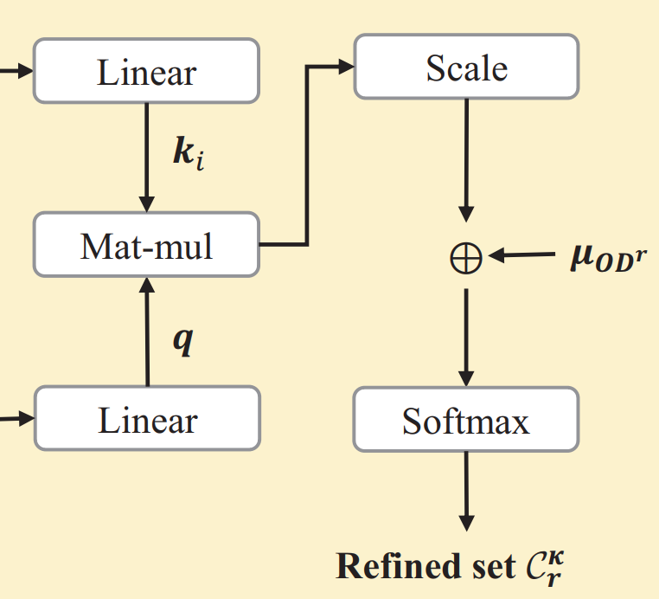
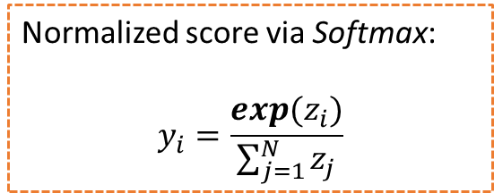
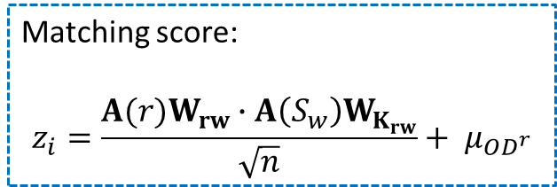

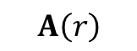
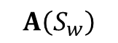

Design of Pre-Matcher
From representations to matching score, and then refined set
Matching score:
$$z_{i}=\frac{A(r)W_{rw}∙A\left(S_{w}\right)W_{K_{rw}}}{\sqrt{n}}+ μ_{{OD}^{r}}$$
Candidate vehicle $w$
$$A\left(S_{w}\right)$$
Normalized score via Softmax:
$$y_{i}=\frac{exp(z_{i})}{\sum_{j=1}^{N}{z_{j}}}$$
Order
$$A\left(r\right)$$
Top $k$

Slide 11
Performance Evaluation
Experimental Setup
Didi’s dataset with 7,065,907 ridesharing transactions
Road network graph from OSM: G (V=214,440, E=466,330)
Baseline ridesharing algorithms
Tshare [TKDE’14]
pGreedyDP [VLDB’18]
Prophet [TODS’22]
mTshare [ICDE’20]
Performance metrics:
Ridesharing performance: order completion rate, average response time, average waiting time, and average detour time
Prediction accuracy: acc@k
Integrating PreMR with baseline and derive variant:
P-Tshare
P-pGreedyDP
P-Prophet
P-mTshare
Notes:
top-κ accuracy, denoted as acc@κ, refers to the percentage of testing cases where the best matching vehicle is among the top κ recommendations

Slide 12
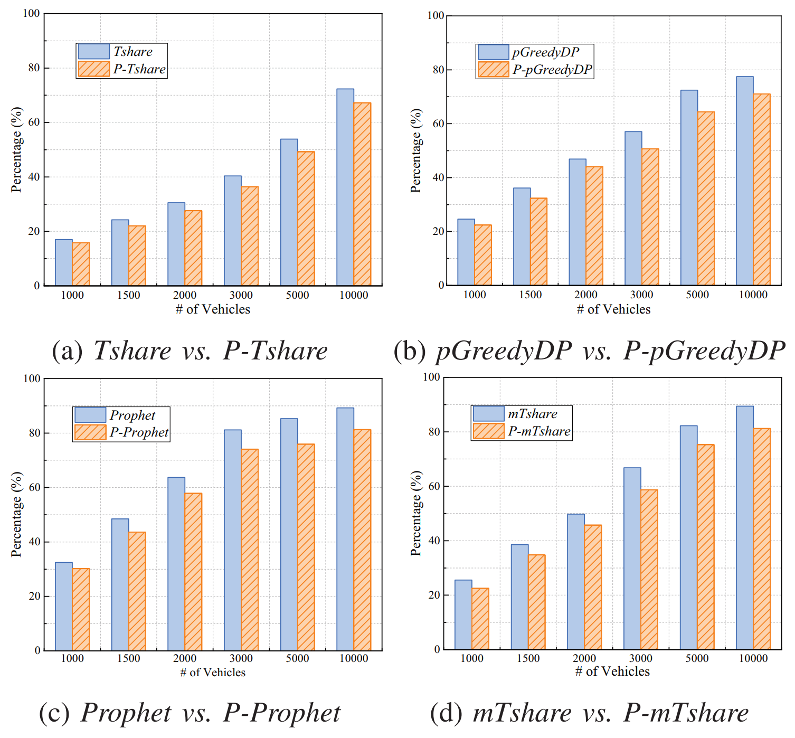
Performance Evaluation
Effectiveness of PreMR
Each variant P-A can successfully fulfill over 90% of the orders served by the original algorithm A.
Fig. The order completion rates of different algorithms.

Slide 13
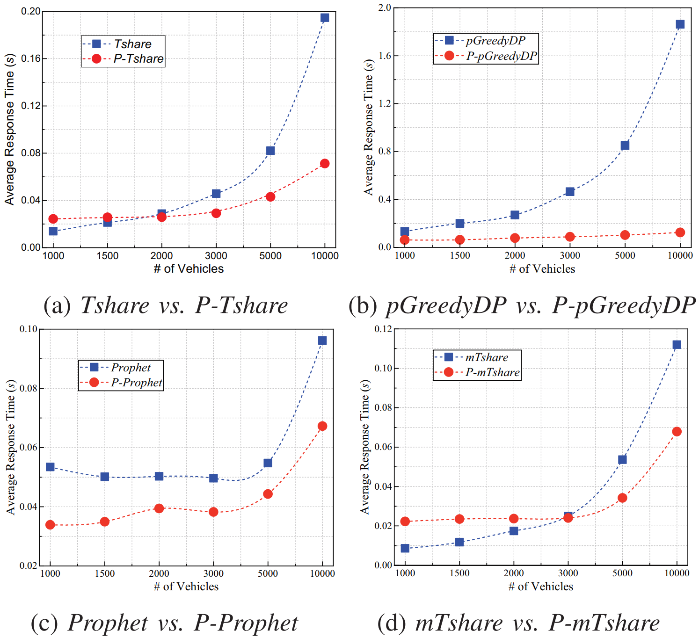
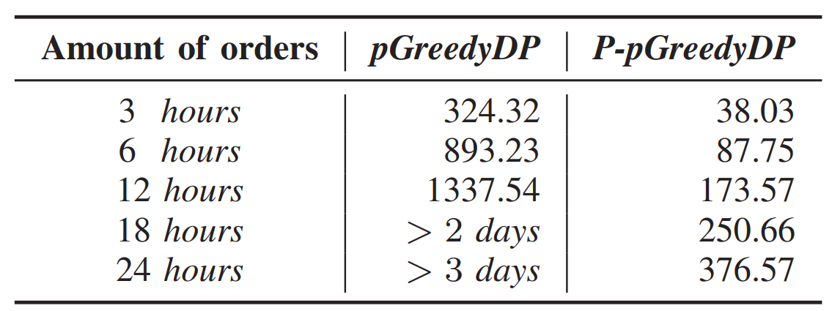
Performance Evaluation
Effectiveness of PreMR
For cases of > 3000 vehicles, PreMR helps to reduce the response time by 46% on average across all baselines.
Table. Comparison on total running time (in minutes) for processing different amounts of orders.
Fig. The average response time of different algorithms.

Slide 14
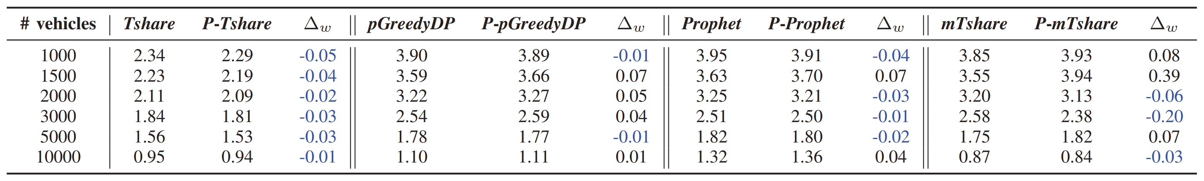
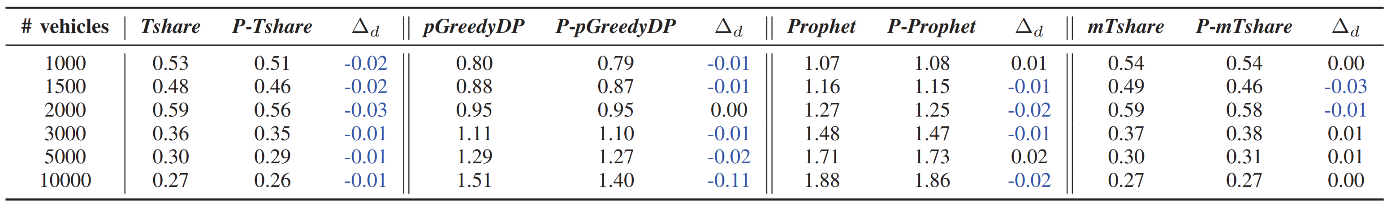
Performance Evaluation
Effectiveness of PreMR
Table. Comparison on the average waiting time (in minutes).
Table. Comparison on the average detour time (in minutes).

Slide 15
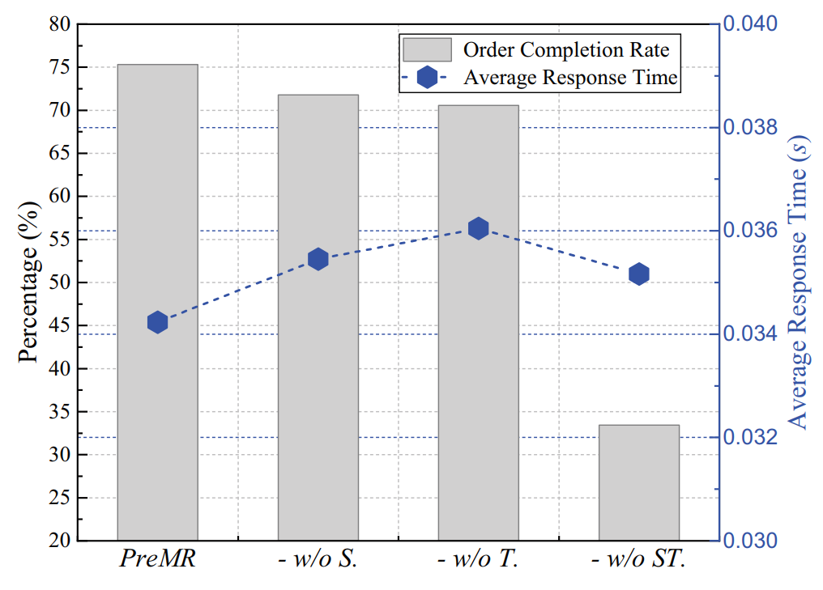
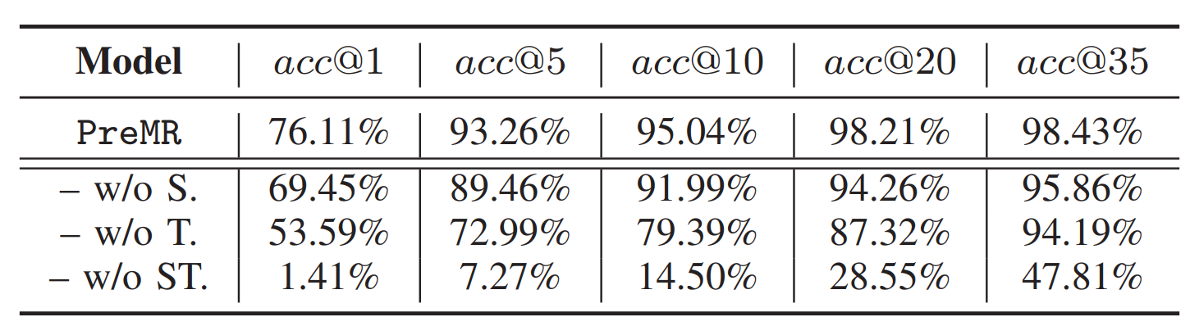

Performance Evaluation
Impact of spatio-temporal relation matrix
w/o S: remove spatial information
w/o T: remove temporal information
w/o ST: remove both spatial and temporal information
Table. Impact of spatial and temporal info. on prediction accuracy.
Fig. Impact of spatial and temporal info. on ridesharing performance.

Slide 16
Conclusion
We propose, as the first time, the problem of order-vehicle pre-matching problem to optimize the candidate sets for ridesharing.
We present a novel solution PreMR that can be integrated with any “filter-and-refine” based ridesharing algorithms and enhance their efficiency.
Extensive experiments on a large real-world dataset have validated the effectiveness of our approach.

Slide 17
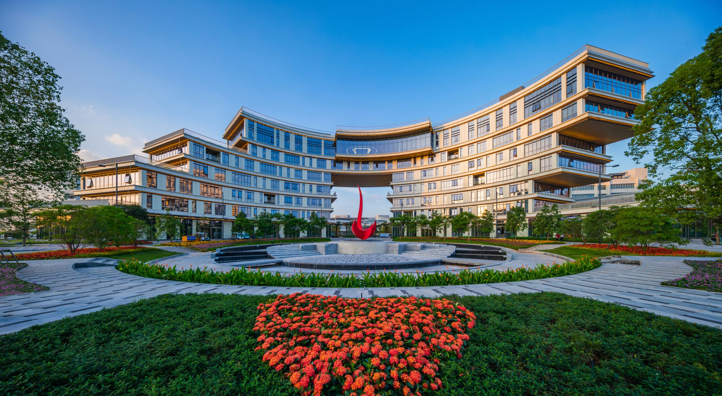
Thank You! Q & A
Zhidan LIU @ HKUST (Guangzhou)
zhidanliu@hkust-gz.edu.cn
https://liuzhidan.github.io/

Slide 18
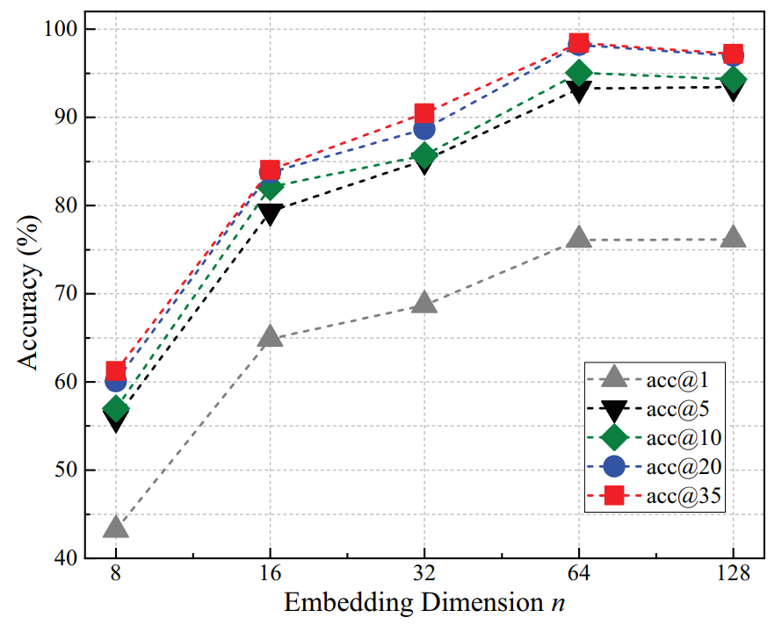
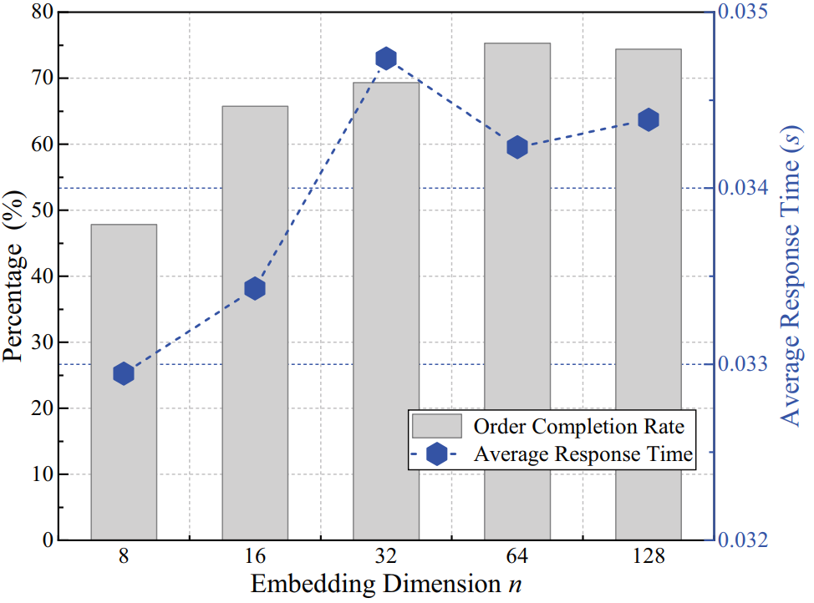
Performance Evaluation
Impact of embedding dimension
Fig. Model prediction accuracy under different embedding dimensions.
Fig. Impact of different embedding dimensions on ridesharing performance.

